Slide 1
Introduction to Compartmental Models
Cara Brook
University of California, Berkeley
Adapted from slides by:
Amy Wesolowski, Johns Hopkins University
Jessica Metcalf, Princeton University

Slide 2
Goals for this lecture
Understand the difference between statistical and mechanistic models Comprendre la différence entre les modèles statistiques et mécanistes.
Understand how to formalize and conceptualize compartmental models Comprendre comment on peut formuler et conceptualiser les modèles compartimentés
Example: population growth, predator prey, SIR models

Slide 3
Goals for this lecture
Understand the difference between statistical and mechanistic models Comprendre la différence entre les modèles statistiques et mécanistes.
Understand how to formalize and conceptualize compartmental models Comprendre comment on peut formuler et conceptualiser les modèles compartimentés
Example: population growth, predator prey, SIR models

Slide 4
Goals for this lecture
Understand the difference between statistical and mechanistic models Comprendre la différence entre les modèles statistiques et mécanistes.
Understand how to formalize and conceptualize compartmental models Comprendre comment on peut formuler et conceptualiser les modèles compartimentés
Example: population growth, predator prey, SIR models

Slide 5
Goals for this lecture
Understand the difference between statistical and mechanistic models Comprendre la différence entre les modèles statistiques et mécanistes.
Understand how to formalize and conceptualize compartmental models Comprendre comment on peut formuler et conceptualiser les modèles compartimentés
Example: population growth, predator prey, SIR models

Slide 6
Compartmental/Mechanistic/Mathematical Models
Populations are divided into compartments Les populations sont subdivisées en compartiments
Individuals within a compartment are homogeneously mixed Les individus d'un compartiment sont mélangés de manière homogène
Compartments and transition rates are determined by biological systems Les compartiments et les taux de transition sont déterminés par les systèmes biologiques
Rates of transferring between compartments are expressed mathematically Taux de transition entre les compartiments sont exprimés mathématiquement

Slide 7
Compartmental/Mechanistic/Mathematical Models
Populations are divided into compartments Les populations sont subdivisées en compartiments
Individuals within a compartment are homogeneously mixed Les individus d'un compartiment sont mélangés de manière homogène
Compartments and transition rates are determined by biological systems Les compartiments et les taux de transition sont déterminés par les systèmes biologiques
Rates of transferring between compartments are expressed mathematically Taux de transition entre les compartiments sont exprimés mathématiquement

Slide 8
Compartmental/Mechanistic/Mathematical Models
Populations are divided into compartments Les populations sont subdivisées en compartiments
Individuals within a compartment are homogeneously mixed Les individus d'un compartiment sont mélangés de manière homogène
Compartments and transition rates are determined by biological systems Les compartiments et les taux de transition sont déterminés par les systèmes biologiques
Rates of transferring between compartments are expressed mathematically Taux de transition entre les compartiments sont exprimés mathématiquement

Slide 9
Compartmental/Mechanistic/Mathematical Models
Populations are divided into compartments Les populations sont subdivisées en compartiments
Individuals within a compartment are homogeneously mixed Les individus d'un compartiment sont mélangés de manière homogène
Compartments and transition rates are determined by biological systems Les compartiments et les taux de transition sont déterminés par les systèmes biologiques
Rates of transferring between compartments are expressed mathematically Taux de transition entre les compartiments sont exprimés mathématiquement

Slide 10
Compartmental/Mechanistic/Mathematical Models
Populations are divided into compartments Les populations sont subdivisées en compartiments
Individuals within a compartment are homogeneously mixed Les individus d'un compartiment sont mélangés de manière homogène
Compartments and transition rates are determined by biological systems Les compartiments et les taux de transition sont déterminés par les systèmes biologiques
Rates of transferring between compartments are expressed mathematically Taux de transition entre les compartiments sont exprimés mathématiquement

Slide 11
How are these different from statistical models? En quoi sont-ils différents des modèles statistiques?
Make explicit hypotheses about biological mechanisms that drive infection dynamics (may not be realistic, but still explicit)
Faire des hypothèses explicites sur les mécanismes biologiques qui régissent la dynamique de l'infection (peut ne pas être réaliste, mais toujours explicite)

Slide 12
How are these different from statistical models? En quoi sont-ils différents des modèles statistiques?
Make explicit hypotheses about biological mechanisms that drive infection dynamics (may not be realistic, but still explicit)
Faire des hypothèses explicites sur les mécanismes biologiques qui régissent la dynamique de l'infection (peut ne pas être réaliste, mais toujours explicite)

Slide 13
1. Simple Population Models 1. Modèles simples de population

Slide 14
Madagascar
http://databank.worldbank.org

Slide 15
The basic
population model
Compartmental models (Mechanistic Models)
Populations are divided into compartments
Individuals within a compartment are homogenously mixed
3. Compartments and transition rates are
determined by biological systems
4. Rates of transferring between compartments
are expressed mathematically
Compartmental models (Mechanistic Models)
1. Les populations sont subdivisées en compartiments
2. Les individus d'un compartiment sont mélangés de manière homogène
3. Les compartiments et les taux de transition sont déterminés par les systèmes biologiques
4. Taux de transition entre les compartiments sont exprimés mathématiquement

Slide 16
The basic
population model
Compartmental models (Mechanistic Models)
Populations are divided into compartments
Individuals within a compartment are homogenously mixed
3. Compartments and transition rates are
determined by biological systems
4. Rates of transferring between compartments
are expressed mathematically
Compartmental models (Mechanistic Models)
1. Les populations sont subdivisées en compartiments
2. Les individus d'un compartiment sont mélangés de manière homogène
3. Les compartiments et les taux de transition sont déterminés par les systèmes biologiques
4. Taux de transition entre les compartiments sont exprimés mathématiquement

Slide 17
The basic
population model
Compartmental models (Mechanistic Models)
Populations are divided into compartments
Individuals within a compartment are homogenously mixed
3. Compartments and transition rates are
determined by biological systems
4. Rates of transferring between compartments
are expressed mathematically
Compartmental models (Mechanistic Models)
1. Les populations sont subdivisées en compartiments
2. Les individus d'un compartiment sont mélangés de manière homogène
3. Les compartiments et les taux de transition sont déterminés par les systèmes biologiques
4. Taux de transition entre les compartiments sont exprimés mathématiquement

Slide 18
The basic
population model
Compartmental models (Mechanistic Models)
Populations are divided into compartments
Individuals within a compartment are homogenously mixed
3. Compartments and transition rates are
determined by biological systems
4. Rates of transferring between compartments
are expressed mathematically
Compartmental models (Mechanistic Models)
1. Les populations sont subdivisées en compartiments
2. Les individus d'un compartiment sont mélangés de manière homogène
3. Les compartiments et les taux de transition sont déterminés par les systèmes biologiques
4. Taux de transition entre les compartiments sont exprimés mathématiquement

Slide 19
The basic
population model
Compartmental models (Mechanistic Models)
1. Populations are divided into compartments
2. Compartments and transition rates are
determined by biological systems
3. Rates of transferring between compartments
are expressed mathematically
4. Individuals within a compartment are homogenously mix
How does the population of Madagascar grow over time?
Comment est-ce que la population de Madagascar s’augmente avec le passage du temps?

Slide 20
The basic
population model
Compartmental models (Mechanistic Models)
1. Populations are divided into compartments
2. Individuals within a compartment are homogenously mixed
3. Compartments and transition rates are
determined by biological systems
4. Rates of transferring between compartments
are expressed mathematically
Madagascar
(N)
Notes:
one category, or state, being alive and in Madagascar - and then flow in from births, out from deaths
how would you calculate population growth?

Slide 21
The basic
population model
Compartmental models (Mechanistic Models)
1. Populations are divided into compartments
2. Individuals within a compartment are homogenously mixed
3. Compartments and transition rates are
determined by biological systems
4. Rates of transferring between compartments
are expressed mathematically
Madagascar
(N)
Notes:
one category, or state, being alive and in Madagascar - and then flow in from births, out from deaths
how would you calculate population growth?

Slide 22
The basic
population model
Compartmental models (Mechanistic Models)
1. Populations are divided into compartments
2. Compartments and transition rates are
determined by biological systems
3. Rates of transferring between compartments
are expressed mathematically
4. Individuals within a compartment are homogenously mix
Madagascar
(N)
How does the population grow?
Notes:
square = ‘state’

Slide 23
The basic
population model
Compartmental models (Mechanistic Models)
1. Populations are divided into compartments
2. Individuals within a compartment are homogenously mixed
3. Compartments and transition rates are
determined by biological systems
4. Rates of transferring between compartments
are expressed mathematically
births
Madagascar
(N)
How does the population grow?
Notes:
two things can happen - birth or death (ignoring migration)
flows = the processes * number of individuals in each
rate = r (= speed per unit time)
flow = rate * pop

Slide 24
The basic
population model
Compartmental models (Mechanistic Models)
1. Populations are divided into compartments
2. Individuals within a compartment are homogenously mixed
3. Compartments and transition rates are
determined by biological systems
4. Rates of transferring between compartments
are expressed mathematically
births
Madagascar
(N)
deaths
How does the population decrease?

Slide 25
The basic
population model
Compartmental models (Mechanistic Models)
1. Populations are divided into compartments
2. Individuals within a compartment are homogenously mixed
3. Compartments and transition rates are
determined by biological systems
4. Rates of transferring between compartments
are expressed mathematically
births
Madagascar
(N)
deaths
N_{t+1}=births*N_{t}-deaths*N_{t}

Slide 26
The basic
population model
Compartmental models (Mechanistic Models)
1. Populations are divided into compartments
2. Individuals within a compartment are homogenously mixed
3. Compartments and transition rates are
determined by biological systems
4. Rates of transferring between compartments
are expressed mathematically
births
Madagascar
(N)
deaths
N_{t+1}=births*N_{t}-deaths*N_{t}

Slide 27
The basic
population model
Compartmental models (Mechanistic Models)
1. Populations are divided into compartments
2. Individuals within a compartment are homogenously mixed
3. Compartments and transition rates are
determined by biological systems
4. Rates of transferring between compartments
are expressed mathematically
births
Madagascar
(N)
deaths
N_{t+1}=births*N_{t}-deaths*N_{t}

Slide 28
The basic
population model
Compartmental models (Mechanistic Models)
1. Populations are divided into compartments
2. Individuals within a compartment are homogenously mixed
3. Compartments and transition rates are
determined by biological systems
4. Rates of transferring between compartments
are expressed mathematically
births
Madagascar
(N)
deaths
N_{t+1}=births*N_{t}-deaths*N_{t}
N_{t+1}=(births-deaths)*N_{t}
N_{t+1}=λ*N_{t}
λ=pop intrinsic growth rate
Notes:
Multiply by where you start from

Slide 29
The basic
population model
births
Madagascar
(N)
deaths
λ=N_{t+1}/N_{t}
Population rate of increase
Taux d'accroissement de la population
pop size at t
pop size at t+1
Notes:
t+1 here could mean 1 year in the future, often done for human populations.
what else is lambda going to equal? births - deaths - could write as N(t+1)=(b-d)N(t) where b and d are per capita birth and death rate
what happens if you start at N[0] ? [make them walk through it! make them identify that we are assuming that population growth stays the SAME]

Slide 30
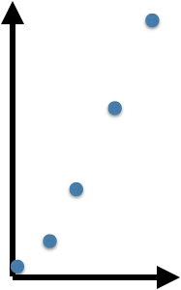
The basic
population model
births
Madagascar
(N)
deaths
Discrete time
λ=N_{t+1}/N_{t}
N₁= 𝜆N₀
N₂= 𝜆[𝜆N₀]=𝜆²N₀
N₃= 𝜆³N₀
N_{t}= 𝜆^{t}N₀
Notes:
discrete vs. continuous- continuous need calculus; discrete usually only algebra…
make them figure out KEY VALUES of lambda [1 = equilibrium; <1 = shrink; >1 grow]

Slide 31
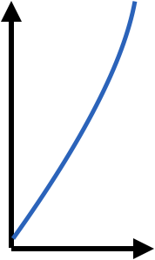
The basic
population model
births
Madagascar
(N)
deaths
Discrete time
Continuous time
population size, N_{t}
λ=N_{t+1}/N_{t}
r= [N(t)-N(0)]/t
population size, N_{t}
!as t→0
time
time
N₁= 𝜆N₀
N₂= 𝜆[𝜆N₀]=𝜆²N₀
N₃= 𝜆³N₀
N_{t}= 𝜆^{t}N₀
dN/dt= rN
Notes:
the ‘derivative is the infinitesimal change in a function relative to one of its variables.

Slide 32
The basic
population model
births
Madagascar
(N)
deaths
Discrete time
Continuous time
dN(t)/dt = rN(t)
Separation of variables:
dN(t)/N(t) = r dt
Integrate both sides:
∫ dN(t)/N(t) = ∫ r dt
By definition:
log(N(t)) = rt + c
Take exponentials:
N(t) = e^{rt + c} = Ce^{rt}
N(t) = N(0)e^{rt}
population size, N_{t}
λ=N_{t+1}/N_{t}
time
N₁= 𝜆N₀
N₂= 𝜆[𝜆N₀]=𝜆²N₀
N₃= 𝜆³N₀
N_{t}= 𝜆^{t}N₀
Notes:
we want to get an answer like the one right at the bottom…. but now for continuous time.

Slide 33
The basic
population model
births
Madagascar
(N)
deaths
Discrete time
Continuous time
dN(t)/dt = rN(t)
Separation of variables:
dN(t)/N(t) = r dt
Integrate both sides:
∫ dN(t)/N(t) = ∫ r dt
By definition:
log(N(t)) = rt + c
Take exponentials:
N(t) = e^{rt + c} = Ce^{rt}
N(t) = N(0)e^{rt}
population size, N_{t}
λ=N_{t+1}/N_{t}
time
N₁= 𝜆N₀
N₂= 𝜆[𝜆N₀]=𝜆²N₀
N₃= 𝜆³N₀
N_{t}= 𝜆^{t}N₀
Notes:
divide by sides by N(t)
what condition for this to be OK? N(t) has to be != from zero

Slide 34
The basic
population model
births
Madagascar
(N)
deaths
Discrete time
Continuous time
dN(t)/dt = rN(t)
Separation of variables:
dN(t)/N(t) = r dt
Integrate both sides:
∫ dN(t)/N(t) = ∫ r dt
By definition:
log(N(t)) = rt + c
Take exponentials:
N(t) = e^{rt + c} = Ce^{rt}
N(t) = N(0)e^{rt}
population size, N_{t}
λ=N_{t+1}/N_{t}
time
N₁= 𝜆N₀
N₂= 𝜆[𝜆N₀]=𝜆²N₀
N₃= 𝜆³N₀
N_{t}= 𝜆^{t}N₀
Notes:
integral of dx/x is log(x); integral of a constant is the constant *x + c

Slide 35
The basic
population model
births
Madagascar
(N)
deaths
Discrete time
Continuous time
dN(t)/dt = rN(t)
Separation of variables:
dN(t)/N(t) = r dt
Integrate both sides:
∫ dN(t)/N(t) = ∫ r dt
By definition:
log(N(t)) = rt + c
Take exponentials:
N(t) = e^{rt + c} = Ce^{rt}
N(t) = N(0)e^{rt}
population size, N_{t}
λ=N_{t+1}/N_{t}
time
N₁= 𝜆N₀
N₂= 𝜆[𝜆N₀]=𝜆²N₀
N₃= 𝜆³N₀
N_{t}= 𝜆^{t}N₀
Notes:
log(P(t)) = rt+c just by rules of derivative
i.e., deriv(log(f(x)) = deriv(f(x))/fIx) so integral the other way

Slide 36
The basic
population model
births
Madagascar
(N)
deaths
Discrete time
Continuous time
population size, N_{t}
λ=N_{t+1}/N_{t}
r=N(t)-N(0)/t
population size, N_{t}
!as t→0
time
time
N₁= 𝜆N₀
N₂= 𝜆[𝜆N₀]=𝜆²N₀
N₃= 𝜆³N₀
N_{t}= 𝜆^{t}N₀
dN(t)/dt = rN(t)
N(t) = N(0)e^{rt}
Notes:
discrete vs. continuous- continuous need calculus; discrete usually only algebra… - but you can often convert between the two, etc. but lets go back to discrete time for a second.

Slide 37
The basic
population model
births
Madagascar
(N)
deaths
Discrete time
Continuous time
population size, N_{t}
λ=N_{t+1}/N_{t}
population size, N_{t}
!as t→0
time
time
Continuous models can be discretized; discrete models can be approximated by continuous ones. The appropriate framing may depend on the data / question.
Notes:
discrete vs. continuous- continuous need calculus; discrete usually only algebra… - but you can often convert between the two, etc. but lets go back to discrete time for a second.

Slide 38
The basic
population model
births
Madagascar
(N)
deaths
What about those rates?
Are they the same every year?
And in every person?

Slide 39

The basic
population model
births
Madagascar
(N)
deaths
if deterministic
“always the same”
probability of death = 0.5

Slide 40

The basic
population model
births
Madagascar
(N)
deaths
if deterministic
“always the same”
probability of death = 0.5

Slide 41
The basic
population model
births
Madagascar
(N)
deaths
if deterministic
“always the same”
probability of death = 0.5
if stochastic?
“up to chance”
probability of death = 0.5

Slide 42

The basic
population model
births
Madagascar
(N)
deaths
if deterministic
“always the same”
probability of death = 0.5
if stochastic?
“up to chance”
probability of death = 0.5

Slide 43
The basic
population model
births
Madagascar
(N)
deaths
if deterministic
“always the same”
probability of death = 0.5
rbinom(200,10,0.5)
if stochastic?
probability of death = 0.5

Slide 44
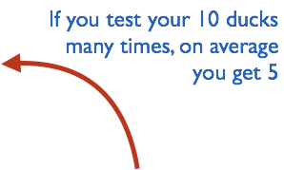
The basic
population model
births
Madagascar
(N)
deaths
if deterministic
“always the same”
probability of death = 0.5
rbinom(200,10,0.5)
if stochastic?
probability of death = 0.5

Slide 45
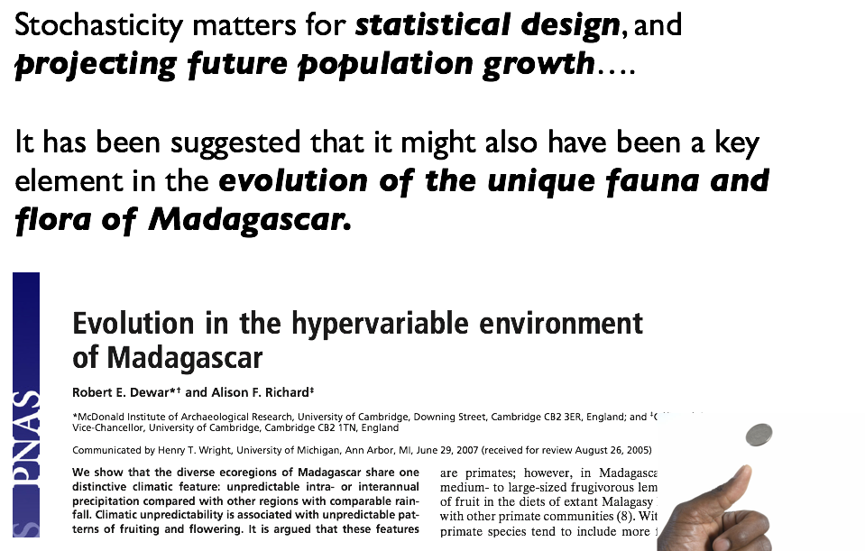

Slide 46
Key concepts
Compartmental/mechanistic/mathematical models
Modèles en compartiments
Continuous vs. discrete models
Modèles en temps continue vs. modèles en temps discrète
Deterministic vs. stochastic models
Modèles détérministique vs. stochastique

Slide 47
2. Structured Population Models 2. Modèles de la population structurée

Slide 48
The structured
population model
Why does the model perform poorly?
births
Ranomafana
(N)
deaths
data
model
population size, N_{t}
time
Notes:
lets go back to discrete time
why is this unlikely to reflect the population of Madagascar? 1) because time-varying of course. 2) Anything else? babies are not having babies

Slide 49
The basic
population model
Why does the model perform poorly?
births
Ranomafana
(N)
deaths
data
We need population structure!
model
population size, N_{t}
time
Notes:
lets go back to discrete time
why is this unlikely to reflect the population of Madagascar? 1) because time-varying of course. 2) Anything else? babies are not having babies

Slide 50
The structured
population model
Compartmental models (Mechanistic Models)
1. Populations are divided into compartments
2. Individuals within a compartment are homogenously mixed
3. Compartments and transition rates are
determined by biological systems
4. Rates of transferring between compartments
are expressed mathematically
How does the population of Ranomafana grow over time?
Comment est-ce que la population de Ranomafana s’augmente avec le passage du temps?
Notes:
what are the arrows? flows between

Slide 51
The structured
population model
Compartmental models (Mechanistic Models)
1. Populations are divided into compartments
2. Individuals within a compartment are homogenously mixed
3. Compartments and transition rates are
determined by biological systems
4. Rates of transferring between compartments
are expressed mathematically
Babies
Adults
Notes:
what are the arrows? flows between

Slide 52
The structured
population model
Compartmental models (Mechanistic Models)
1. Populations are divided into compartments
2. Individuals within a compartment are homogenously mixed
3. Compartments and transition rates are
determined by biological systems
4. Rates of transferring between compartments
are expressed mathematically
Babies
Adults
Notes:
what are the arrows? flows between

Slide 53
The structured
population model
Compartmental models (Mechanistic Models)
1. Populations are divided into compartments
2. Individuals within a compartment are homogenously mixed
3. Compartments and transition rates are
determined by biological systems
4. Rates of transferring between compartments
are expressed mathematically
births
Babies
aging
Adults
deaths
deaths
Notes:
what are the arrows? flows between

Slide 54
The structured
population model
Compartmental models (Mechanistic Models)
1. Populations are divided into compartments
2. Individuals within a compartment are homogenously mixed
3. Compartments and transition rates are
determined by biological systems
4. Rates of transferring between compartments
are expressed mathematically
births (B)
Babies
aging
(a)
Adults
deaths
deaths
λ=N_{t+1}/N_{t}
vector of
population sizes
s_{b}(1-a)
B
pop size at t
s_{b}a
s_{a}
pop size at t + 1
Population rate of increase
Taux d'accroissement de la population
Notes:
what are the arrows? flows between

Slide 55
The structured
population model
Compartmental models (Mechanistic Models)
1. Populations are divided into compartments
2. Individuals within a compartment are homogenously mixed
3. Compartments and transition rates are
determined by biological systems
4. Rates of transferring between compartments
are expressed mathematically
births (B)
Babies
aging
(a)
Adults
deaths
deaths
λ=N_{t+1}/N_{t}
vector of
population sizes
s_{b}(1-a)
B
pop size at t
s_{b}a
s_{a}
pop size at t + 1
Population rate of increase
*Discrete time
Taux d'accroissement de la population
Notes:
what are the arrows? flows between

Slide 56
The structured
population model
Compartmental models (Mechanistic Models)
1. Populations are divided into compartments
2. Individuals within a compartment are homogenously mixed
3. Compartments and transition rates are
determined by biological systems
4. Rates of transferring between compartments
are expressed mathematically
births (B)
Babies
aging
(a)
Adults
deaths
deaths
A
n_{t}
n_{t+1}
s_{b}(1-a)
B
n_{b}
s_{b}(1-a) n_{b} + bn_{a}
x
=
s_{b}a
s_{a}
n_{a}
s_{b} a n_{b} + s_{a}n_{a}
Notes:
what are the arrows? flows between

Slide 57
The structured
population model
Compartmental models (Mechanistic Models)
1. Populations are divided into compartments
2. Individuals within a compartment are homogenously mixed
3. Compartments and transition rates are
determined by biological systems
4. Rates of transferring between compartments
are expressed mathematically
births (B)
Babies
aging
(a)
Adults
deaths
deaths
A
n_{t}
n_{t+1}
s_{b}(1-a)
B
n_{b}
s_{b}(1-a) n_{b} + bn_{a}
x
=
s_{b}a
s_{a}
n_{a}
s_{b} a n_{b} + s_{a}n_{a}
Population growth will depend on population structure!
Notes:
what are the arrows? flows between

Slide 58
The structured
population model
Compartmental models (Mechanistic Models)
1. Populations are divided into compartments
2. Individuals within a compartment are homogenously mixed
3. Compartments and transition rates are
determined by biological systems
4. Rates of transferring between compartments
are expressed mathematically
births (B)
Babies
aging
(a)
Adults
deaths
deaths
Notes:
what are the arrows? flows between

Slide 59
Key concepts
Compartmental/mechanistic/mathematical models
Modèles en compartiments
Continuous vs. discrete models
Modèles en temps continue vs. modèles en temps discrète
Deterministic vs. stochastic models
Modèles détérministique vs. stochastique
Structured models
Modèles structurés.

Slide 60
3. Two-population model 3. modèles de deux populations

Slide 61
The predator-prey model
Compartmental models (Mechanistic Models)
1. Populations are divided into compartments
2. Individuals within a compartment are homogenously mixed
3. Compartments and transition rates are
determined by biological systems
4. Rates of transferring between compartments
are expressed mathematically
How does the population of fossa regulate the population of lemurs in Ranomafana?
Comment la population de “fossa” régule la population de lemuriens à Ranomafana?

Slide 62
The predator-prey model
Compartmental models (Mechanistic Models)
1. Populations are divided into compartments
2. Individuals within a compartment are homogenously mixed
3. Compartments and transition rates are
determined by biological systems
4. Rates of transferring between compartments
are expressed mathematically
lemur
(x)
fossa
(y)

Slide 63
The predator-prey model
Compartmental models (Mechanistic Models)
1. Populations are divided into compartments
2. Individuals within a compartment are homogenously mixed
3. Compartments and transition rates are
determined by biological systems
4. Rates of transferring between compartments
are expressed mathematically
lemur
(x)
fossa
(y)

Slide 64
The predator-prey model
Compartmental models (Mechanistic Models)
1. Populations are divided into compartments
2. Individuals within a compartment are homogenously mixed
3. Compartments and transition rates are
determined by biological systems
4. Rates of transferring between compartments
are expressed mathematically
lemur reproduction
lemur
(x)
lemur death
fossa reproduction
fossa
(y)
fossa death

Slide 65
The predator-prey model
Compartmental models (Mechanistic Models)
1. Populations are divided into compartments
2. Individuals within a compartment are homogenously mixed
3. Compartments and transition rates are
determined by biological systems
4. Rates of transferring between compartments
are expressed mathematically
lemur reproduction
lemur
(x)
lemur death
fossa reproduction
(depends on lemur population)
fossa
(y)
fossa death

Slide 66
The predator-prey model
Compartmental models (Mechanistic Models)
1. Populations are divided into compartments
2. Individuals within a compartment are homogenously mixed
3. Compartments and transition rates are
determined by biological systems
4. Rates of transferring between compartments
are expressed mathematically
lemur reproduction
lemur
(x)
lemur death
(depends on fossa population)
fossa reproduction
(depends on lemur population)
fossa
(y)
fossa death

Slide 67
The predator-prey model
Compartmental models (Mechanistic Models)
1. Populations are divided into compartments
2. Individuals within a compartment are homogenously mixed
3. Compartments and transition rates are
determined by biological systems
4. Rates of transferring between compartments
are expressed mathematically
lemur reproduction
lemur
(x)
Parameters
: lemur rep. rate
: lemur death rate
: fossa rep. rate
: fossa death rate
lemur death
(depends on fossa population)
fossa reproduction
(depends on lemur population)
fossa
(y)
fossa death

Slide 68
The predator-prey model
Compartmental models (Mechanistic Models)
1. Populations are divided into compartments
2. Individuals within a compartment are homogenously mixed
3. Compartments and transition rates are
determined by biological systems
4. Rates of transferring between compartments
are expressed mathematically
lemur reproduction
lemur
(x)
Parameters
: lemur rep. rate
: lemur death rate
: fossa rep. rate
: fossa death rate
lemur death
(depends on fossa population)
fossa reproduction
(depends on lemur population)
fossa
(y)
fossa death

Slide 69
The predator-prey model
Compartmental models (Mechanistic Models)
1. Populations are divided into compartments
2. Individuals within a compartment are homogenously mixed
3. Compartments and transition rates are
determined by biological systems
4. Rates of transferring between compartments
are expressed mathematically
lemur reproduction
lemur
(x)
Parameters
: lemur rep. rate
: lemur death rate
: fossa rep. rate
: fossa death rate
lemur death
(depends on fossa population)
fossa reproduction
(depends on lemur population)
fossa
(y)
fossa death

Slide 70
The predator-prey model
Compartmental models (Mechanistic Models)
1. Populations are divided into compartments
2. Individuals within a compartment are homogenously mixed
3. Compartments and transition rates are
determined by biological systems
4. Rates of transferring between compartments
are expressed mathematically
lemur reproduction
lemur
(x)
lemur death
(depends on fossa population)
fossa reproduction
(depends on lemur population)
fossa
(y)
SOME ASSUMPTIONS
• the lemur has an unlimited food supply
• the lemur only dies from being eaten by fossa
• the fossa is totally dependent on a single prey species (the lemur) as its only food supply
fossa death

Slide 71
The predator-prey model
Lemurs
Fossas

Slide 72
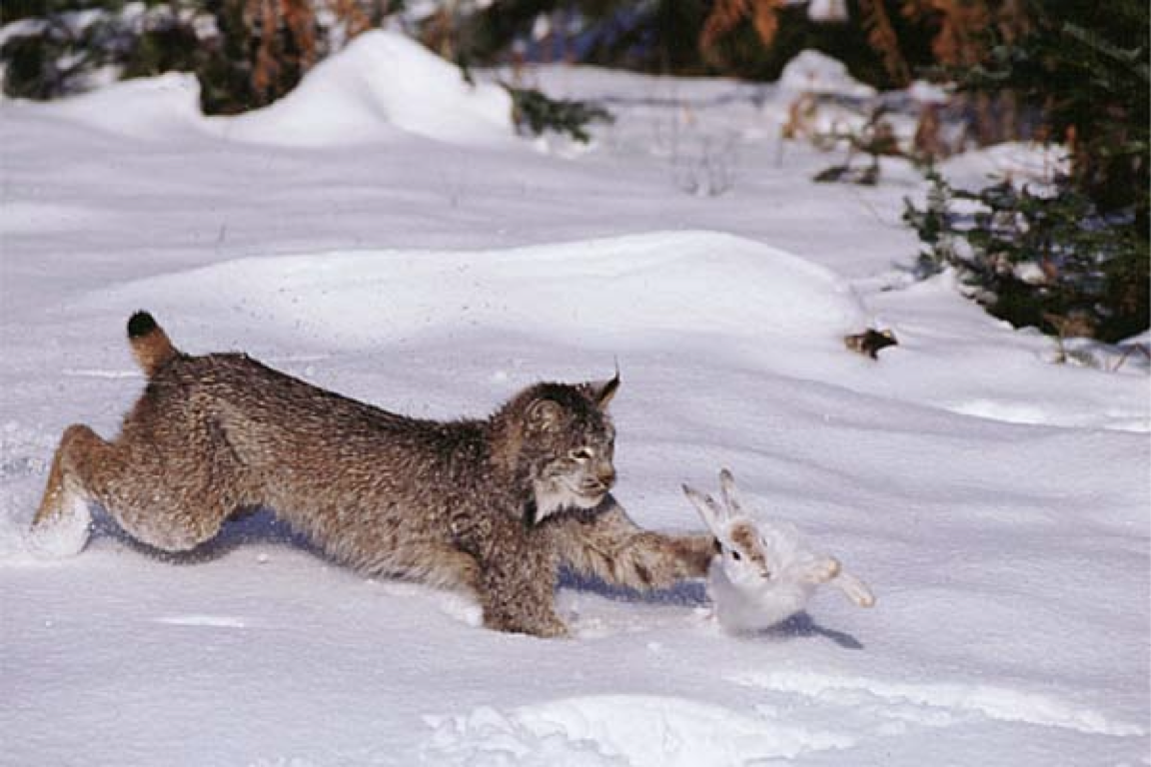
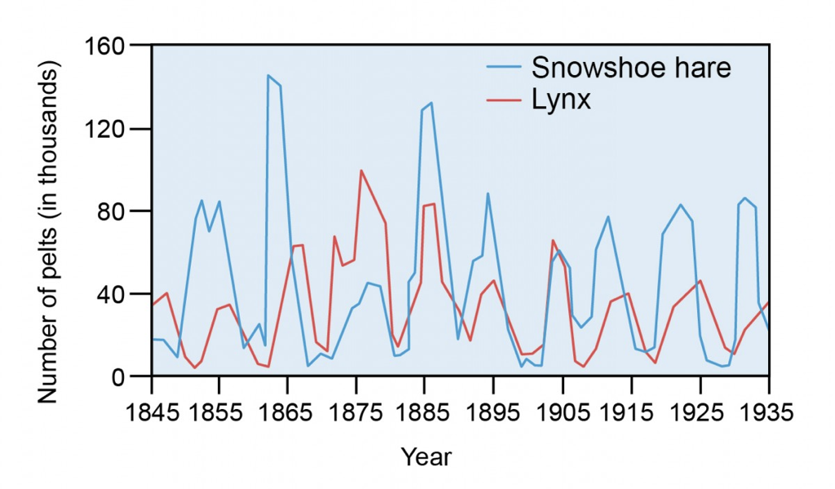
The predator-prey model

Slide 73
Key concepts
Compartmental/mechanistic/mathematical models
Modèles en compartiments
Continuous vs. discrete models
Modèles en temps continue vs. modèles en temps discrète
Deterministic vs. stochastic models
Modèles détérministique vs. stochastique
Structured models
Modèles structurés.
Two population models
Modèles des deux populations

Slide 74

4. SIR Models 4. Les modèles SIR

Slide 75
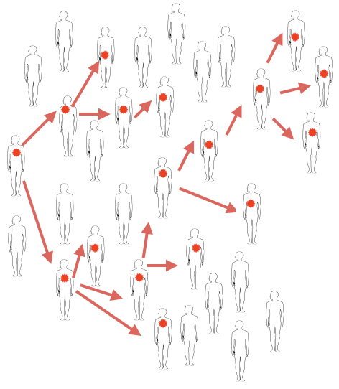

Slide 76
The SIR model
Compartmental models (Mechanistic Models)
1. Populations are divided into compartments
2. Individuals within a compartment are homogenously mixed
3. Compartments and transition rates are
determined by biological systems
4. Rates of transferring between compartments
are expressed mathematically
How does measles transmit through Antananarivo?
Comment la rougéole se transmet-elle à Antananarivo?
Notes:
When I say “build a model” I mean “create a stylized version of reality”. Here - we are assuming that everyone in the world falls into one of these three categories. …Key to remember, all models are wrong - some models are useful…
SAY: measles = rougeole, mumps = oreillons; rubella = rubella

Slide 77
The SIR model
Compartmental models (Mechanistic Models)
1. Populations are divided into compartments
2. Individuals within a compartment are homogenously mixed
3. Compartments and transition rates are
determined by biological systems
4. Rates of transferring between compartments
are expressed mathematically
susceptible
infectious
recovered
S
I
R
Notes:
When I say “build a model” I mean “create a stylized version of reality”. Here - we are assuming that everyone in the world falls into one of these three categories. …Key to remember, all models are wrong - some models are useful…
SAY: measles = rougeole, mumps = oreillons; rubella = rubella

Slide 78
The SIR model
Compartmental models (Mechanistic Models)
1. Populations are divided into compartments
2. Individuals within a compartment are homogenously mixed
3. Compartments and transition rates are
determined by biological systems
4. Rates of transferring between compartments
are expressed mathematically
susceptible
infectious
recovered
S
I
R
What are the big assumptions here?
Notes:
When I say “build a model” I mean “create a stylized version of reality”. Here - we are assuming that everyone in the world falls into one of these three categories. …Key to remember, all models are wrong - some models are useful…
SAY: measles = rougeole, mumps = oreillons; rubella = rubella

Slide 79
The SIR model
Compartmental models (Mechanistic Models)
1. Populations are divided into compartments
2. Individuals within a compartment are homogenously mixed
3. Compartments and transition rates are
determined by biological systems
4. Rates of transferring between compartments
are expressed mathematically
everyone is either:
susceptible
infectious
recovered
S
I
R
What are the big assumptions here?
Notes:
When I say “build a model” I mean “create a stylized version of reality”. Here - we are assuming that everyone in the world falls into one of these three categories. …Key to remember, all models are wrong - some models are useful…
SAY: measles = rougeole, mumps = oreillons; rubella = rubella

Slide 80
The SIR model
Compartmental models (Mechanistic Models)
1. Populations are divided into compartments
2. Individuals within a compartment are homogenously mixed
3. Compartments and transition rates are
determined by biological systems
4. Rates of transferring between compartments
are expressed mathematically
everyone is either:
susceptible
infectious
recovered
S
I
R
people mix uniformly (mass action)
les gens se mélangent uniformément
Notes:
When I say “build a model” I mean “create a stylized version of reality”. Here - we are assuming that everyone in the world falls into one of these three categories. …Key to remember, all models are wrong - some models are useful…
SAY: measles = rougeole, mumps = oreillons; rubella = rubella

Slide 81
The SIR model
Compartmental models (Mechanistic Models)
1. Populations are divided into compartments
2. Individuals within a compartment are homogenously mixed
3. Compartments and transition rates are
determined by biological systems
4. Rates of transferring between compartments
are expressed mathematically
susceptible
infectious
recovered
S
I
R
infection
recovery
people mix uniformly (mass action)
no latent period
(infectious when infected)
les gens se mélangent uniformément
pas de période de latence
Notes:
When I say “build a model” I mean “create a stylized version of reality”. Here - we are assuming that everyone in the world falls into one of these three categories. …Key to remember, all models are wrong - some models are useful…
SAY: measles = rougeole, mumps = oreillons; rubella = rubella

Slide 82
The SIR model
Compartmental models (Mechanistic Models)
1. Populations are divided into compartments
2. Individuals within a compartment are homogenously mixed
3. Compartments and transition rates are
determined by biological systems
4. Rates of transferring between compartments
are expressed mathematically
susceptible
infectious
recovered
S
I
R
recovery is permanent
infection
recovery
la récupération est permanente
people mix uniformly (mass action)
no latent period
(infectious when infected)
les gens se mélangent uniformément
pas de période de latence
Notes:
When I say “build a model” I mean “create a stylized version of reality”. Here - we are assuming that everyone in the world falls into one of these three categories. …Key to remember, all models are wrong - some models are useful…
SAY: measles = rougeole, mumps = oreillons; rubella = rubella

Slide 83
The SIR model
Compartmental models (Mechanistic Models)
1. Populations are divided into compartments
2. Individuals within a compartment are homogenously mixed
3. Compartments and transition rates are
determined by biological systems
4. Rates of transferring between compartments
are expressed mathematically
population size constant - no births or deaths, migration
taille de population constante
susceptible
infectious
recovered
S
I
R
recovery is permanent
infection
recovery
la récupération est permanente
people mix uniformly (mass action)
no latent period
(infectious when infected)
les gens se mélangent uniformément
pas de période de latence
Notes:
When I say “build a model” I mean “create a stylized version of reality”. Here - we are assuming that everyone in the world falls into one of these three categories. …Key to remember, all models are wrong - some models are useful…
SAY: measles = rougeole, mumps = oreillons; rubella = rubella

Slide 84
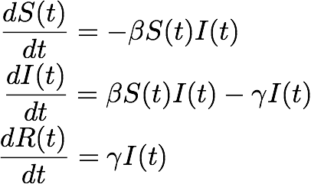
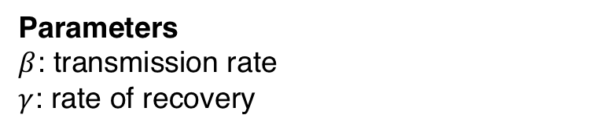
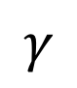
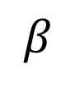
The SIR model
Compartmental models (Mechanistic Models)
1. Populations are divided into compartments
2. Individuals within a compartment are homogenously mixed
3. Compartments and transition rates are
determined by biological systems
4. Rates of transferring between compartments
are expressed mathematically
Parameters
$β$: transmission rate
$γ$: rate of recovery
susceptible
infectious
recovered
S
I
R
infection
recovery
$$β$$
$$γ$$
Notes:
When I say “build a model” I mean “create a stylized version of reality”. Here - we are assuming that everyone in the world falls into one of these three categories. …Key to remember, all models are wrong - some models are useful…
SAY: measles = rougeole, mumps = oreillons; rubella = rubella

Slide 85
The SIR model
Compartmental models (Mechanistic Models)
1. Populations are divided into compartments
2. Individuals within a compartment are homogenously mixed
3. Compartments and transition rates are
determined by biological systems
4. Rates of transferring between compartments
are expressed mathematically
Parameters
$β$: transmission rate
$γ$: rate of recovery
susceptible
infectious
recovered
S
I
R
infection
recovery
$$β$$
$$γ$$
…multiply rates by box you start in….
Notes:
When I say “build a model” I mean “create a stylized version of reality”. Here - we are assuming that everyone in the world falls into one of these three categories. …Key to remember, all models are wrong - some models are useful…
SAY: measles = rougeole, mumps = oreillons; rubella = rubella

Slide 86
The SIR model
Compartmental models (Mechanistic Models)
1. Populations are divided into compartments
2. Individuals within a compartment are homogenously mixed
3. Compartments and transition rates are
determined by biological systems
4. Rates of transferring between compartments
are expressed mathematically
Parameters
$β$: transmission rate
$γ$: rate of recovery
susceptible
infectious
recovered
S
I
R
transmission
recovery
$$β$$
$$γ$$
…infected numbers influence the transmission rate….
Notes:
When I say “build a model” I mean “create a stylized version of reality”. Here - we are assuming that everyone in the world falls into one of these three categories. …Key to remember, all models are wrong - some models are useful…
SAY: measles = rougeole, mumps = oreillons; rubella = rubella

Slide 87
The SIR model
Compartmental models (Mechanistic Models)
1. Populations are divided into compartments
2. Individuals within a compartment are homogenously mixed
3. Compartments and transition rates are
determined by biological systems
4. Rates of transferring between compartments
are expressed mathematically
Parameters
$β$: transmission rate
$γ$: rate of recovery
susceptible
infectious
recovered
S
I
R
transmission
recovery
$$β$$
$$γ$$
What will the dynamics look like?
Notes:
When I say “build a model” I mean “create a stylized version of reality”. Here - we are assuming that everyone in the world falls into one of these three categories. …Key to remember, all models are wrong - some models are useful…
SAY: measles = rougeole, mumps = oreillons; rubella = rubella

Slide 88
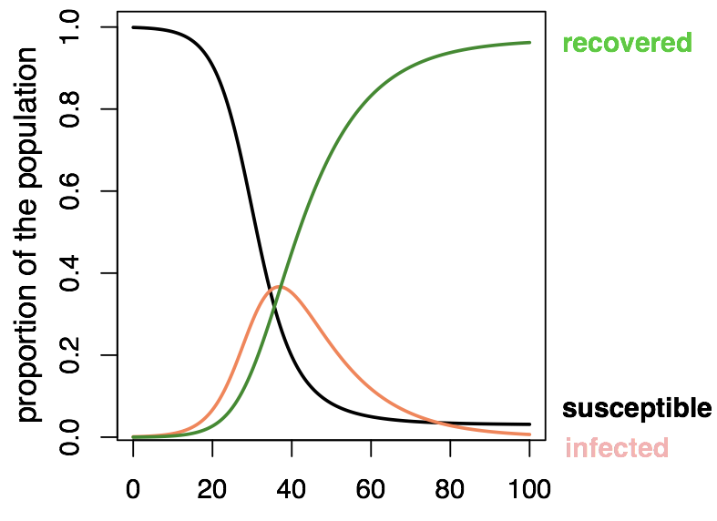
The SIR model

Slide 89
The SIR model
? Epidemic ends even though there are still some susceptibles….HOW?

Slide 90
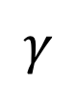
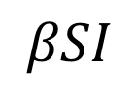
The SIR model
Set: I=1
I
transmission
recovery
$$βSI$$
$$γ$$
The average number of persons infected by an infectious individual when everyone is susceptible (S=100%, or S=1, start of an epidemic)

Slide 91
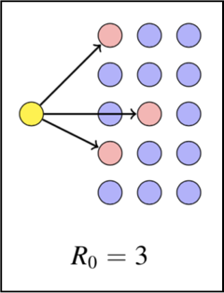
The SIR model
Set: I=1
I
transmission
recovery
$$βSI$$
$$γ$$
The average number of persons infected by an infectious individual when everyone is susceptible (S=100%, or S=1, start of an epidemic)

Slide 92
The SIR model

Slide 93
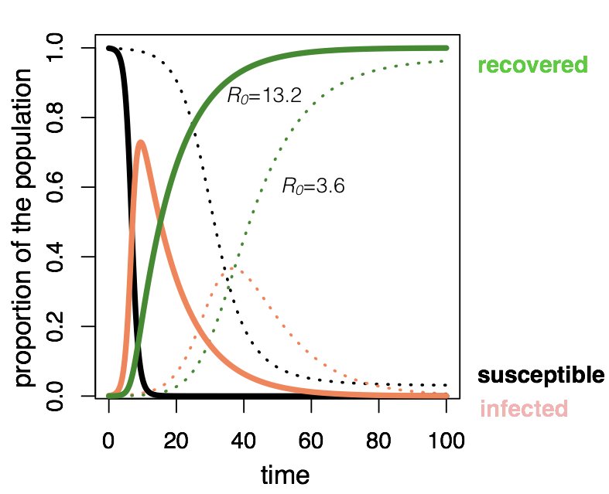
The SIR model

Slide 94
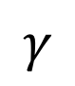
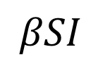
The SIR model
Set: I=1
I
transmission
recovery
$$βSI$$
$$γ$$
The average number of persons infected by an infectious individual when everyone is susceptible (S=100%, or S=1, start of an epidemic)
R_{E} =
“R-effective"
…as the epidemic progresses and S falls

Slide 95
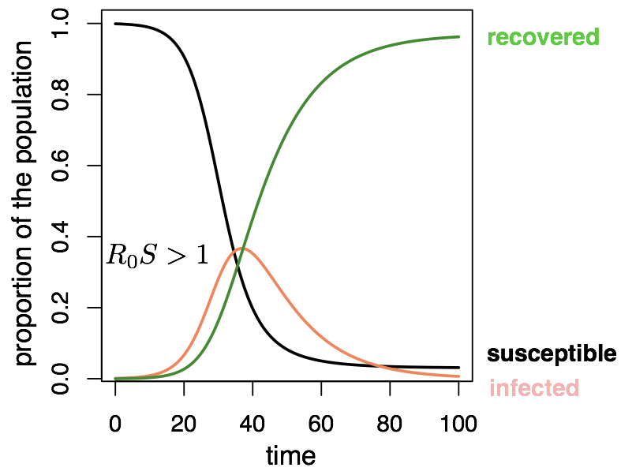
The SIR model

Slide 96
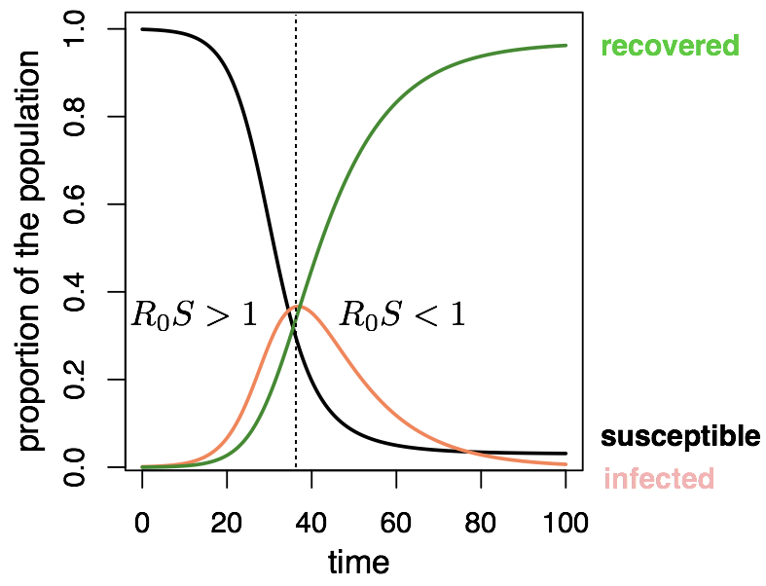
The SIR model

Slide 97
The SIR model : vaccination
S
I
R
transmission
recovery
vaccination
Vaccination moves people out of susceptibles into the immune (recovered) class.
La vaccination éloigne les personnes sensibles de la maladie dans la classe immunitaire (rétablie).

Slide 98
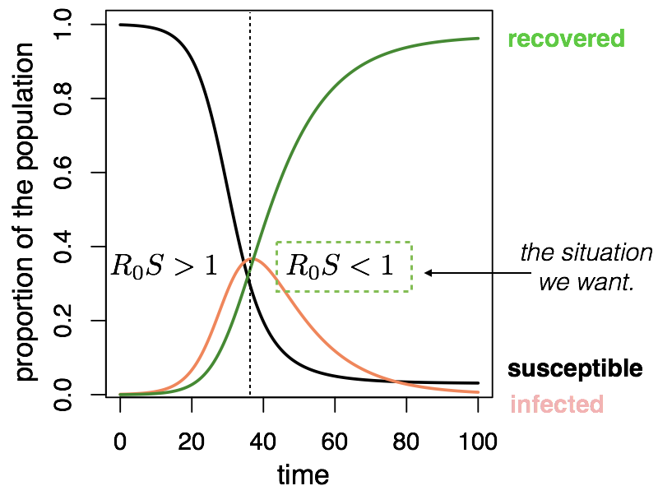
The SIR model : vaccination

Slide 99
The SIR model : vaccination
Proportion that needs to be vaccinated to interrupt transmission

Slide 100
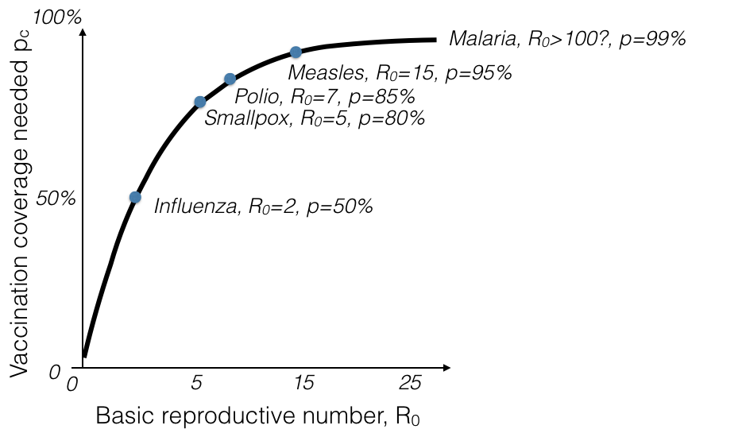
The SIR model : eradication
More transmissible diseases are harder to eradicate

Slide 101

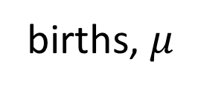
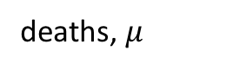
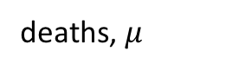
The SIR model : extensions
Moving beyond a ‘closed’ population
births, $μ$
transmission
recovery
S
I
R
vaccination, p
deaths, $μ$
deaths, $μ$
deaths, $μ$

Slide 102
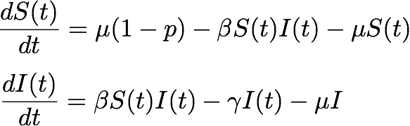
The SIR model : extensions
Moving beyond a ‘closed’ population
births, $μ$
transmission
recovery
S
I
R
vaccination, p
deaths, $μ$
deaths, $μ$
deaths, $μ$

Slide 103
The SIR model : add births
Moving beyond a ‘closed’ population
births, $μ$
transmission
recovery
S
I
R
vaccination, p
deaths, $μ$
deaths, $μ$
deaths, $μ$
What is likely to be the BIGGEST dynamical difference?

Slide 104
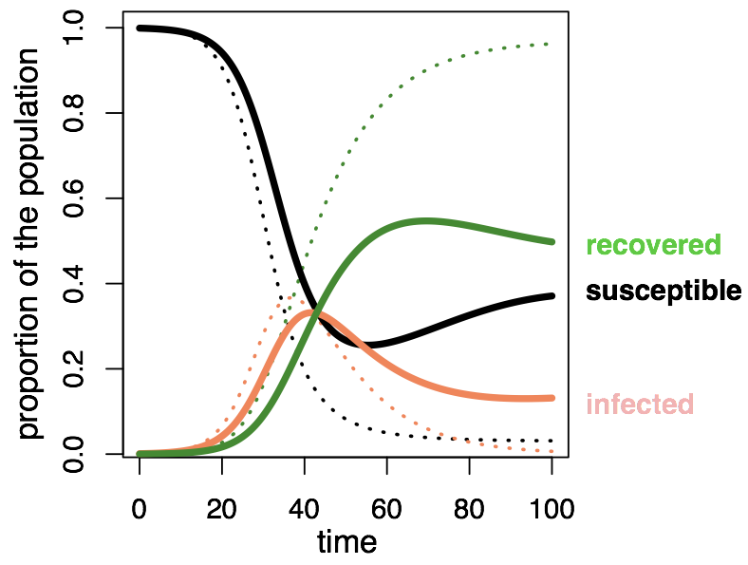
The SIR model : add births
Notes:
Infection will persist

Slide 105
Beyond the SIR model
births, $μ$
transmission
recovery
S
I
R
vaccination, p
deaths, $μ$
deaths, $μ$
deaths, $μ$
What do we change if infection is always FATAL?

Slide 106

Beyond the SIR model
births, $μ$
transmission
S
I
vaccination, p
deaths, $α$
deaths, $μ$
deaths, $μ$
What do we change if infection is always FATAL?

Slide 107
Beyond the SIR model
births, $μ$
transmission
recovery
S
I
R
vaccination, p
deaths, $μ$
deaths, $μ$
deaths, $μ$
What if immunity wanes?

Slide 108
Beyond the SIR model
waning immunity
births, $μ$
transmission
recovery
S
I
R
vaccination, p
deaths, $μ$
deaths, $μ$
deaths, $μ$
What if immunity wanes?

Slide 109
Beyond the SIR model
births, $μ$
transmission
recovery
S
I
R
vaccination, p
deaths, $μ$
deaths, $μ$
deaths, $μ$
What if people recover at different rates?

Slide 110
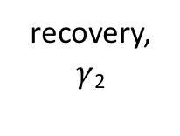
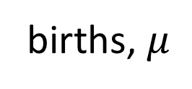
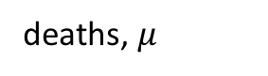
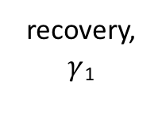
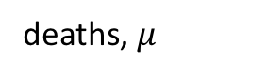


Beyond the SIR model
births, $μ$
transmission
recovery, $γ$₁
vaccination, p
S
I₁
R
deaths, $μ$
deaths, $μ$
deaths, $μ$
transmission
I₂
recovery, $γ$₂
deaths, $μ$
What if people recover at different rates?

Slide 111
Key concepts
Compartmental/mechanistic/mathematical models
Modèles en compartiments
Continuous vs. discrete models
Modèles en temps continue vs. modèles en temps discrète
Deterministic vs. stochastic models
Modèles détérministique vs. stochastique
Structured models
Modèles structurés.
Two population models
Modèles des deux populations
SIR models – and beyond!
Modèles SIR – et au délà!

Slide 112
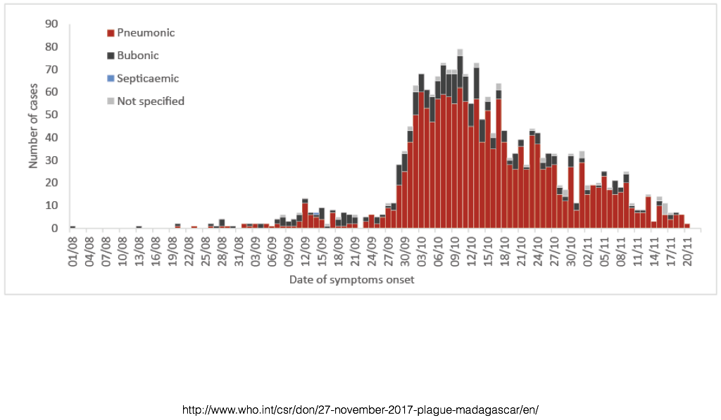
Which model?
Notes:
and the point will be it depends on the question.
https://www.ncbi.nlm.nih.gov/pmc/articles/PMC2566243/

